Slide 1

GLUCOSENSE- AI-POWERED DIABETES DETECTION FOR EARLY INTERVENTION
Infosys Springboard
Team: Rahul Thota, Rethasvi Chede, Shantanu

Slide 2

PROBLEM STATEMENT
The rising prevalence of diabetes globally highlights the need for early prediction and intervention. By leveraging machine learning, this project aims to predict diabetes risk based on patient data, enabling timely medical action

Slide 3
STEPS INVOLVED
Data Collection
– Statistics of healthcare and lifestyle survey information
Data Exploration (EDA) and Data Preprocessing
Feature Selection and dimension reduction approaches
Build a classification model
Evaluation metrics

Slide 4
DATASET FEATURES
Basic Information: Age, Gender
Symptoms: Polyuria, Polydipsia, Sudden Weight Loss, Weakness, Polyphagia
Related Conditions: Genital Thrush, Visual Blurring, Irritability, Partial Paresis, Alopecia

Slide 5
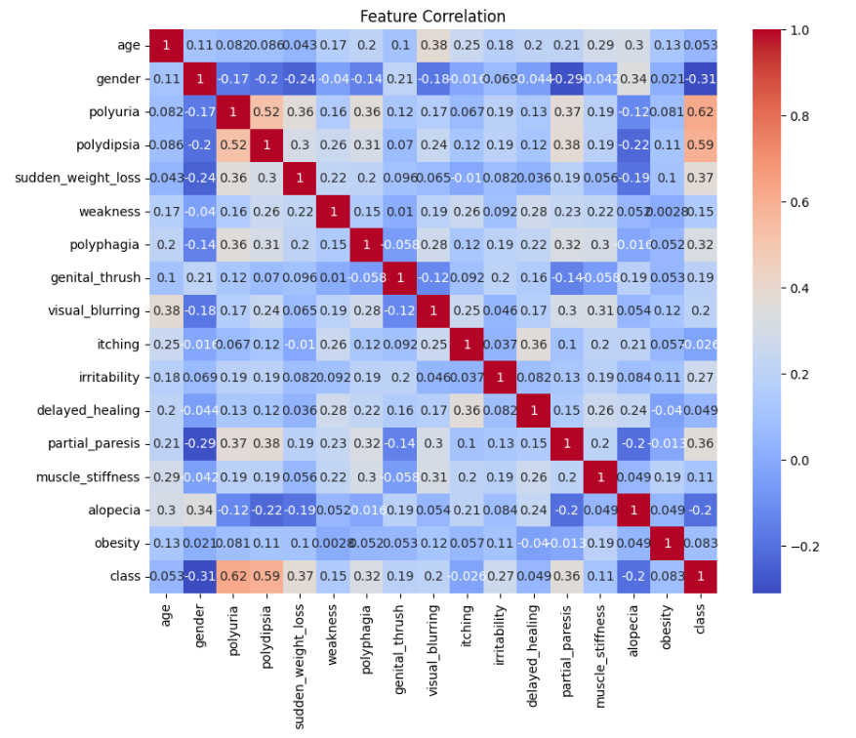
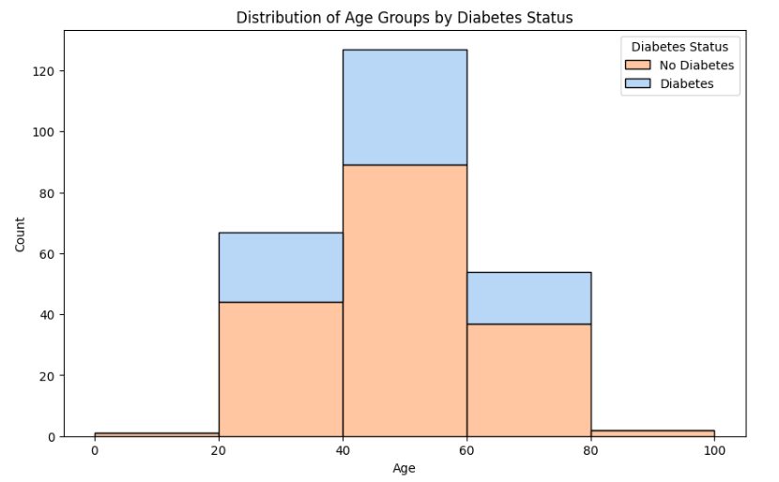
VISUALIZATION

Slide 6
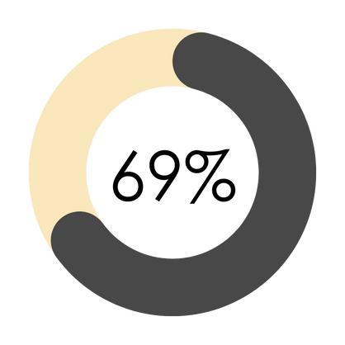
TARGET VARIABLE
69% of individuals in the dataset are diagnosed with diabetes
31% of individuals in the dataset do not have diabetes

Slide 7
MODELS APPLIED TO THE DATASET
Logistic Regression (LR)
Support Vector Machine (SVM)
Random Forest (RF)
Decision Tree (DT)
Extra Trees (ET)
Gradient Boosting (GB)
XGBoost (XGB)

Slide 8
METRICS AFTER MODELLLING
Model | Accuracy | Precision | Recall | F1-Score
Logistic Regression | 0.823529 | 0.825000 | 0.942857 | 0.880000
Decision Tree | 0.882353 | 0.891892 | 0.942857 | 0.916667
Support Vector Machine | 0.901961 | 0.894737 | 0.971429 | 0.931507
Random Forest | 0.921569 | 0.918919 | 0.971429 | 0.944444
Gradient Boosting | 0.901961 | 0.894737 | 0.971429 | 0.931507
Extra Trees | 0.921569 | 0.918919 | 0.971429 | 0.944444
XGBoost | 0.882353 | 0.891892 | 0.942857 | 0.916667

Slide 9
METRICS AFTER HYPERPARAMETER TUNING
Model | Accuracy | Precision | Recall | F1-Score
Logistic Regression | 0.862745 | 0.850000 | 0.971429 | 0.906667
Decision Tree | 0.882353 | 0.891892 | 0.942857 | 0.916667
Support Vector Machine | 0.882353 | 0.871795 | 0.971429 | 0.918919
Random Forest | 0.901961 | 0.916667 | 0.942857 | 0.929577
Gradient Boosting | 0.862745 | 0.888889 | 0.914286 | 0.901408
Extra Trees | 0.921569 | 0.918919 | 0.971429 | 0.944444
XGBoost | 0.901961 | 0.894737 | 0.971429 | 0.931507

Slide 10
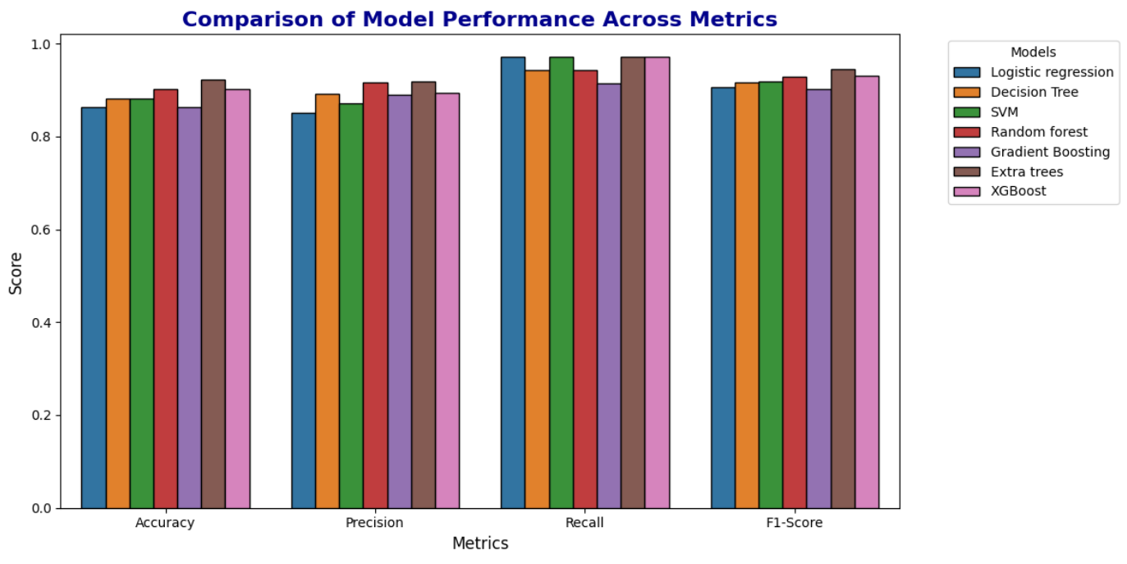
METRICS COMPARISON

Slide 11
CHOOSING THE BEST MODEL
Best Model: Extra Trees
Why Extra Trees?
- Highest Accuracy: 92.16%
- High Precision: 91.89% (fewer false positives)
- Excellent Recall: 97.14% (captures most positives)
- Best F1-Score: 94.44%
Close Contenders: Random Forest and XGBoost (slightly lower metrics).

Slide 12
DIABETES PREDICTION USING MACHINE LEARNING
An Infosys Springboard Internship Project
Team:
Rahul Thota
Rethasvi Chede
Shantanu

Slide 13
THANK YOU!

